Slide 1
Javascript
An Introduction

Slide 2
INTRODUCTION
A programming language .
Adds interactivity and custom behaviors
Client side scripting language.

Slide 3
CHARACTERISTICS
Lightweight and powerful scripting language.
Dynamic programming language.
Loosely typed.

Slide 4
Its nothing to do with java.
Created by Netscape in 1955 originally called “Livescript”.

Slide 5
What Javascript can do..
For adding interactivity to a web page.
Structural layer-markup
Presentation layer – CSS
Behavioral layer – Javascript
Usage of DOM.

Slide 6
Allows to create highly responsive interfaces to improve user experience.
Provides dynamic capability
Google suggestions
Ajax
Collapsible content area.

Slide 7
Adding Javascript to a Page
Embedded Script
<script>
//javascript code here
</script>
External script
Usage SRC attribute.
<script src=“my_script.js”></script>
Script Placement

Slide 8
Basics
Javascript is case-sensetive.
Statements are commands.
Alert(‘thank you’);
Comments
Single line comment - //
Multi-line Comment - /* */

Slide 9
Contd..
Variables
A variable is an information container.
Var m=10;
Data Types
Undefined
Null
Numbers
Strings
Booleans

Slide 10
Arrays
Group of multiple Values.
Indexing using numbers.
Var Cars=[‘BMW’,’Audi’,’Lamborghini’];
Alert(Cars[0]);
Alert(Cars[1]);
Alert(Cars[2]);

Slide 11
Comparison Operators
== Is Equal to
!= Not Equal to
=== Is Identical to
!== Not Identical to
> Greater than
< Less than
>= greater than or equal to
<= less than or equal to

Slide 12
Functions
A bit of code that runs when it is referenced or called.
Alert();
Syntax
Function function_name(){
//block of code
}

Slide 13
Native functions
Alert() , confirm(), and prompt()
Date() ;
parseInt(‘123’);
setTimeout(funcion_name, 5000);
Custom functions
Function function_name(){
//code for function
}
Arguments.
Return value.

Slide 14
Browser object
Not just control the elements but also manipulate.
In javascript, the browser is known as window object.
There are various properties methods associated with window object

Slide 15
Property/Method | Description
Event | Represents the state of an event
History | Visited URL’s within the browser
Location | Read /write access to URI
Status | Sets/returns the text in status bar
Alert() | An alert box with specified message
Close() | Close the current window
Confirm() | Dialog box with msg and ‘ok’ and ‘cancel’ button.

Slide 16
Events
It is a action that can be detected using javascript.
Example
Loading of a page
Movement of mouse cursor.
User clicks
An event can be identified using event handlers.

Slide 17
Event handler | Description
Onblur | An element loses focus
Onclick | The mouse click object
Onfocus | An element gets focus
Onkeydown | A key on keyboard is pressed
Onkeypress | A key is pressed down or held down
Onload | A page or an image is finished loading
Onmouseout | The mouse is moved
Onmouseover | The mouse is moved off an element

Slide 18
3 common ways of applying event handlers.
As an HTML attribute
As a method attached to the element
Using addEventListener

Slide 19
DOM
Document object model gives us a way to access and manipulate the contents of the document.
It provides a structured map of the document.
It translates our markup into a format that javascript can understand.

Slide 20
By using dom we can access any element by their names or attributes.
We can add , modify or delete elements and their contents using javascript.

Slide 21
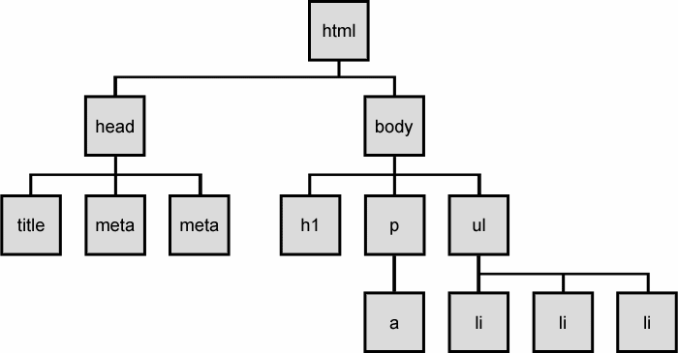
Node Tree

Slide 22
Accessing DOM nodes
Document is the object that identifies the web page itself.
Document.getElementById(‘_id_name’)
By element name
getElementsByTagName()
By class attribute Value
getElementsByClassName()

